Slide 1
ABC Pharmacy Drug Dispensing and Tracking System
Medha Mallampati SHP Rutgers University BINF5115: Healthcare Database Management Riddhi Vyas

Slide 2
Overview
The purpose of the project is to demonstrate designing a database, database tables, referential integrity, and database functionality.
System Overview
Database Design
ER Diagram
Table Creations
Queries Statements and Results
Database Max Functionality

Slide 3
System Overview
As part of this project, a hypothetical ABC Pharmacy Drug Dispensing and Tracking System is designed. The system contains information about the Drug Supplier, Drug Inventory, Licensed Pharmacists who dispense/provide the Drugs (prescription, OTC, dietary supplements) to Patient’s who are given a Prescription by Doctor. At any time this system can Track the Drug from Drug Supplier to the end Patient, including the Doctor who prescribed, as well as the Pharmacist who provided dispensing services. In case of recalls, side-effects, supply shortage, etc., the tracking system will quickly identify the entire supply chain and alert Patients and Doctors using the contact information provided.
(Disclaimer: All the data loaded into the tables are purely fictitious)

Slide 4

Database Design
Database:
Tables:
Pharmacy
Drug Manufacturer
Doctor
Patients
Drugs
Pharmacist
Prescription
Prescription Items
Orders
Order Details

Slide 5
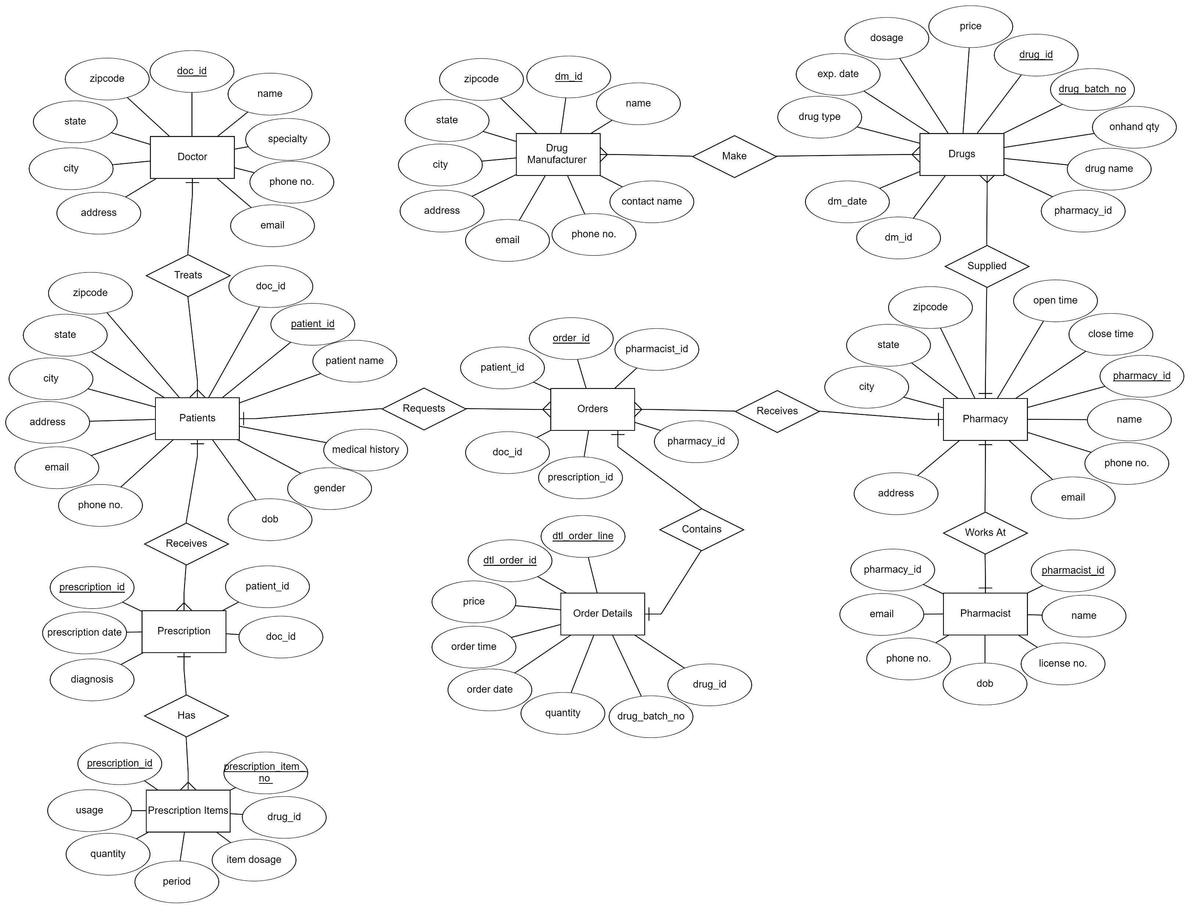
ER Diagram

Slide 6
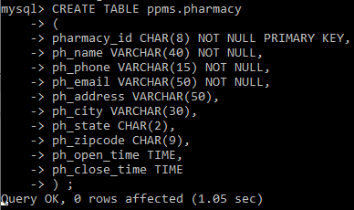
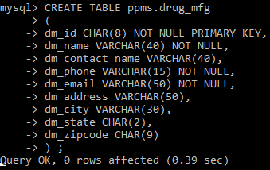
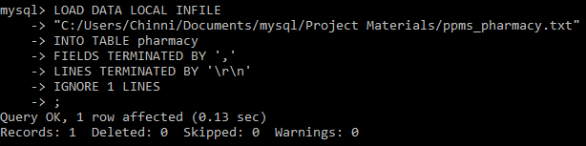
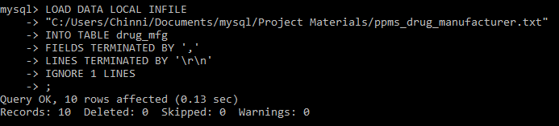
Table Creations
Table 1: Pharmacy
Table 2: Drug Manufacturer

Slide 7
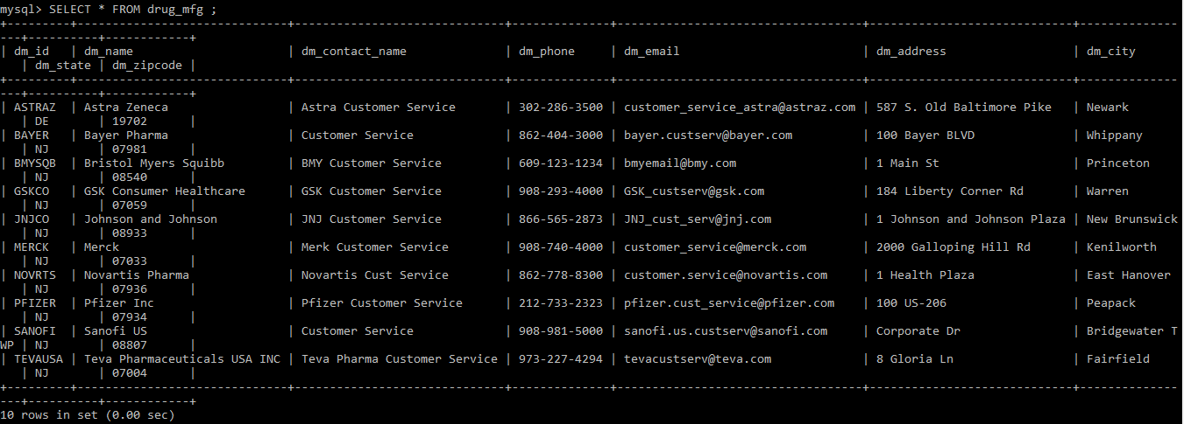
Table Creations
Table 1: Pharmacy
Table 2: Drug Manufacturer

Slide 8
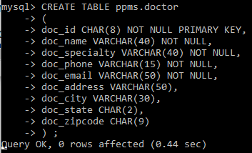
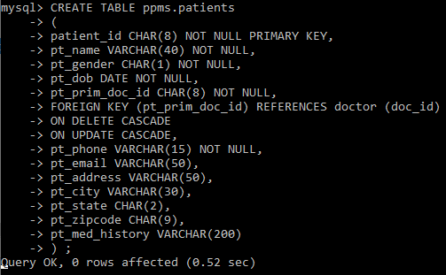
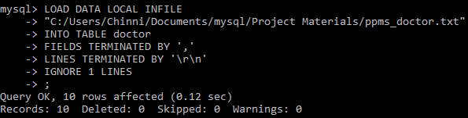
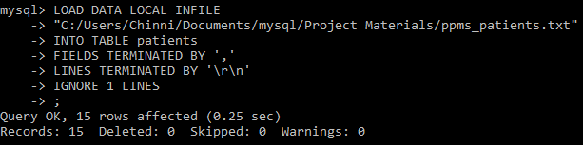
Table Creations
Table 3: Doctor
Table 4: Patients

Slide 9
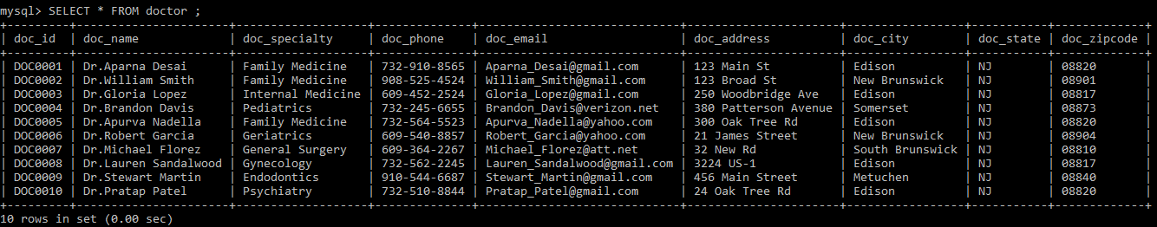
Table Creations
Table 3: Doctor

Slide 10
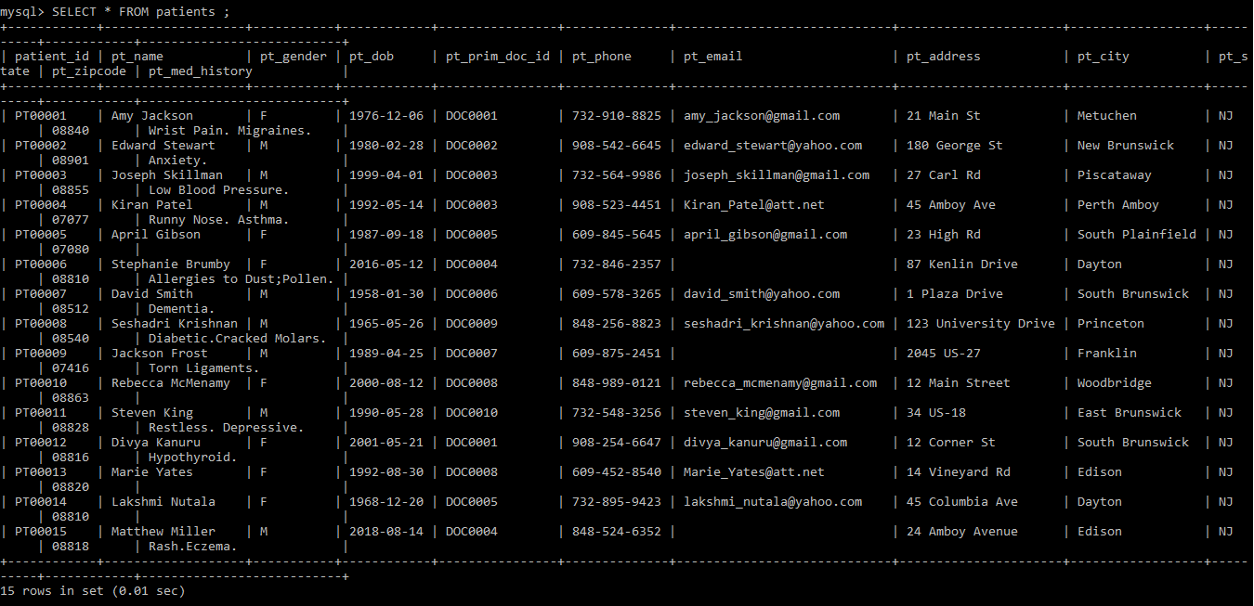
Table Creations
Table 4: Patients

Slide 11
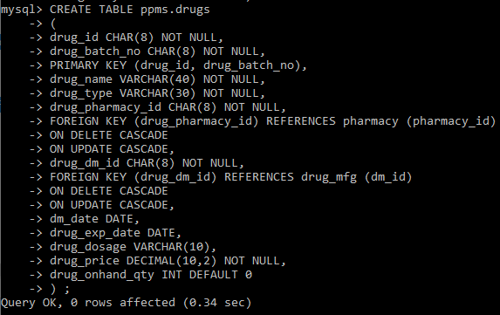
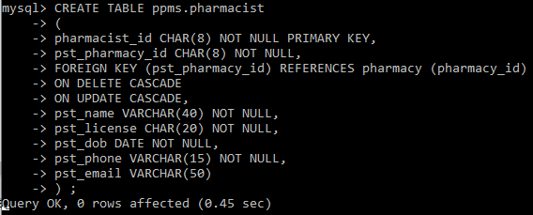
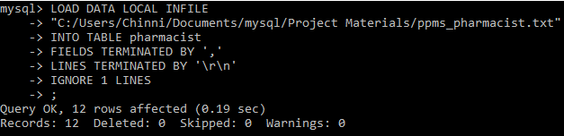
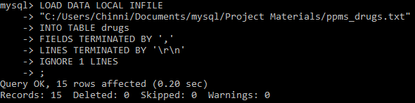
Table Creations
Table 5: Drugs
Table 6: Pharmacist

Slide 12
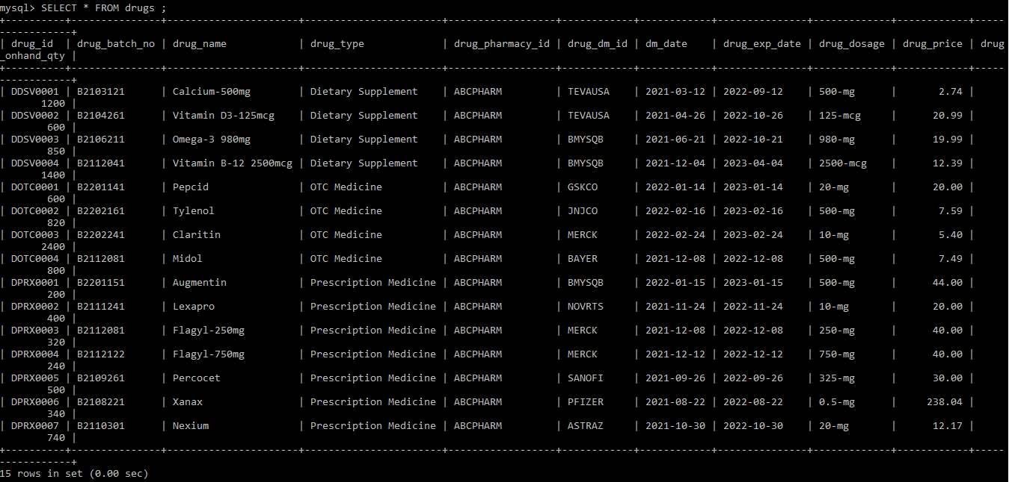
Table Creations
Table 5: Drugs

Slide 13
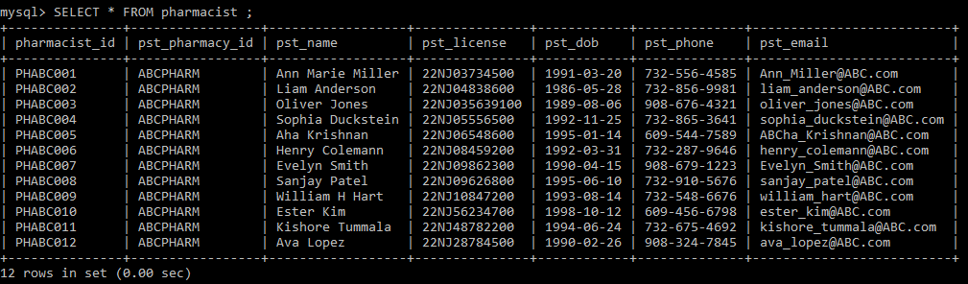
Table Creations
Table 6: Pharmacist

Slide 14
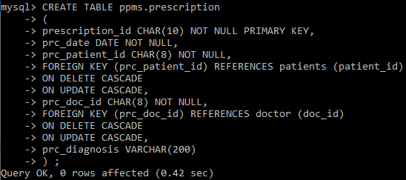
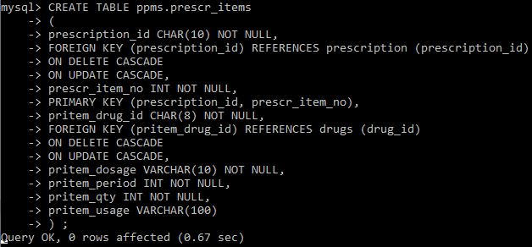
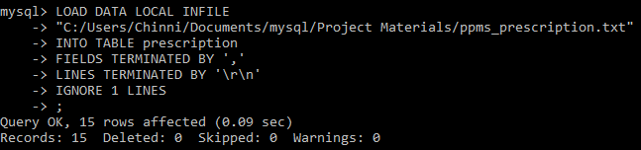
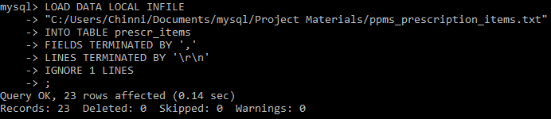
Table Creations
Table 7: Prescription
Table 8: Prescription Items

Slide 15
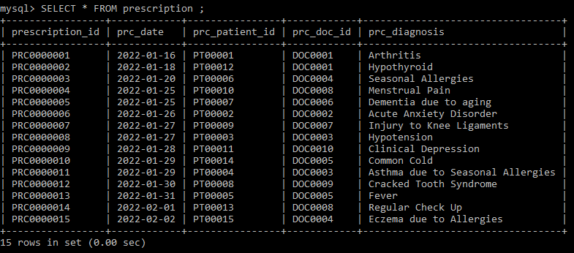
Table Creations
Table 7: Prescription

Slide 16
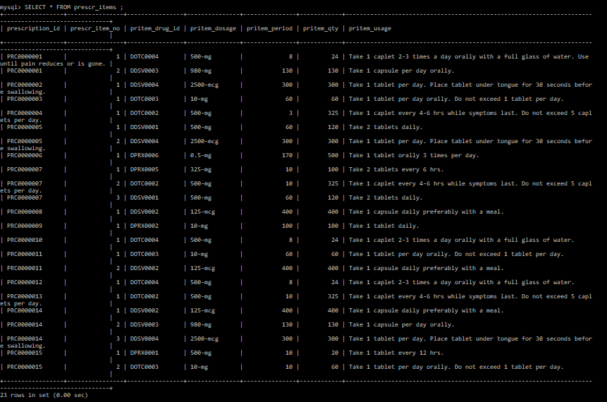
Table Creations
Table 8: Prescription Items

Slide 17
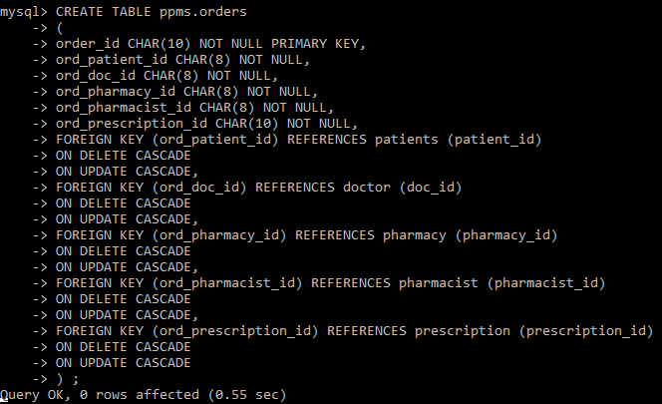
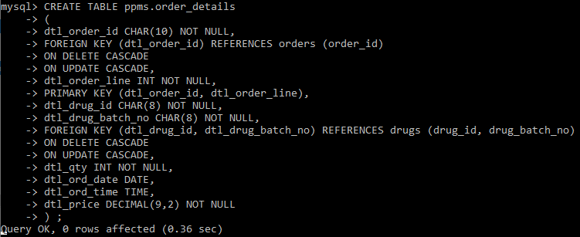
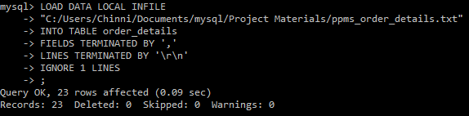
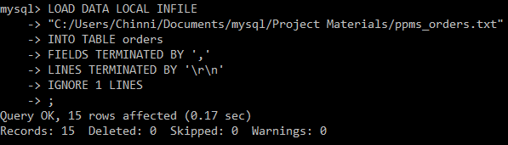
Table Creations
Table 9: Orders
Table 10: Order Items

Slide 18
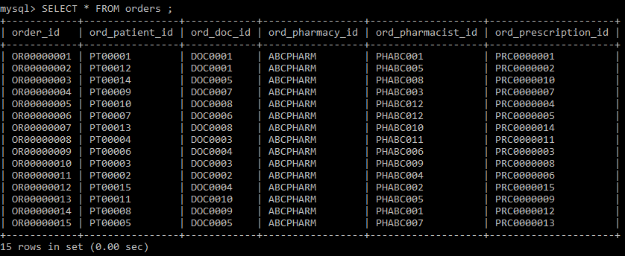
Table Creations
Table 9: Orders

Slide 19
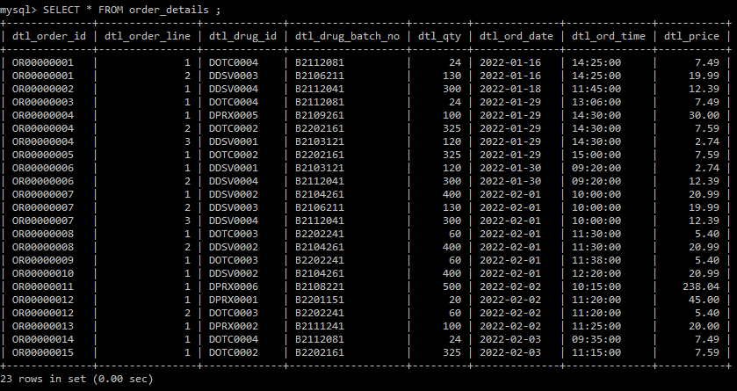
Table Creations
Table 10: Order Items

Slide 20
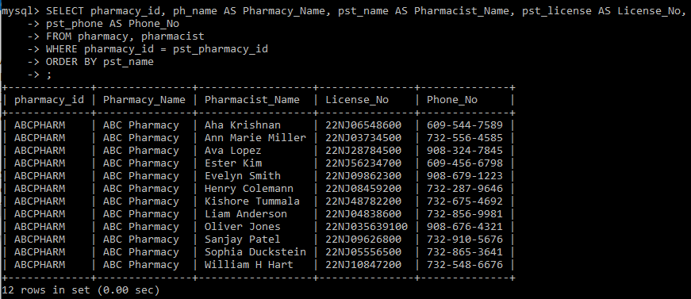
Queries Statements and Results
List of Pharmacists working in Pharmacy ABCPharm

Slide 21
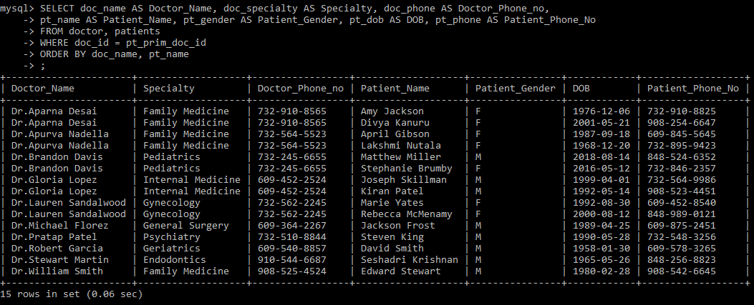
Queries Statements and Results
Patients List by Primary Doctor

Slide 22
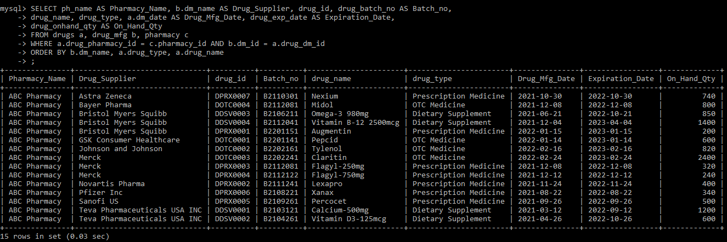
Queries Statements and Results
Pharmacy Drug Supplier and On-hand Inventory

Slide 23
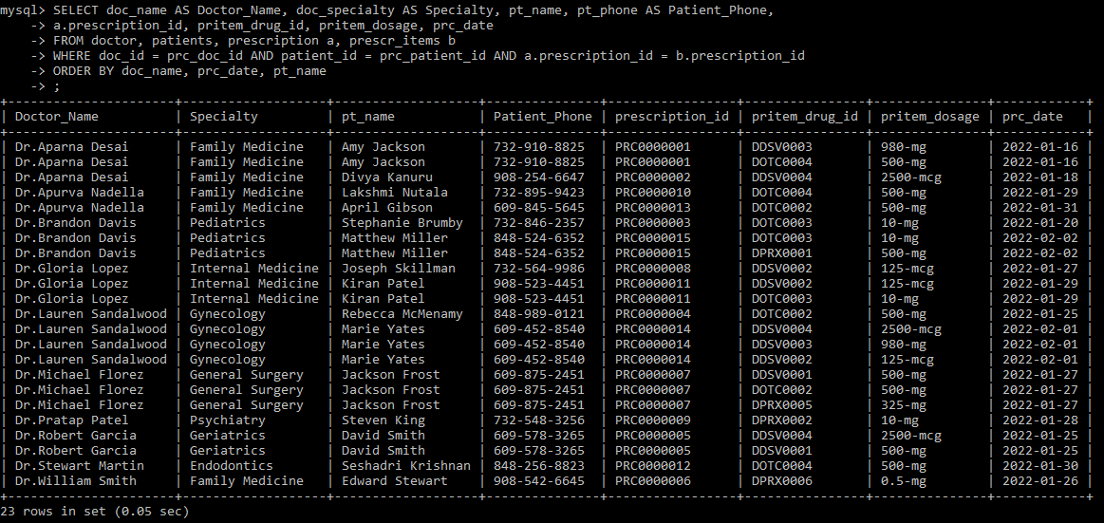
Queries Statements and Results
Patients Prescription by Doctor

Slide 24
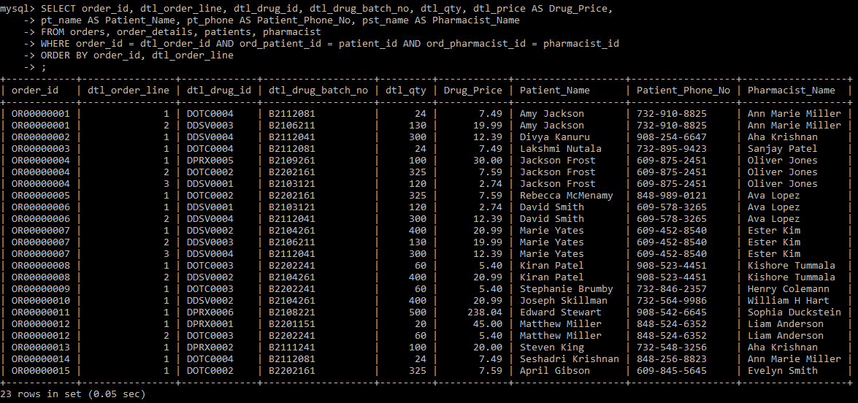
Queries Statements and Results
List Pharmacy Orders and extended amount by Date

Slide 25
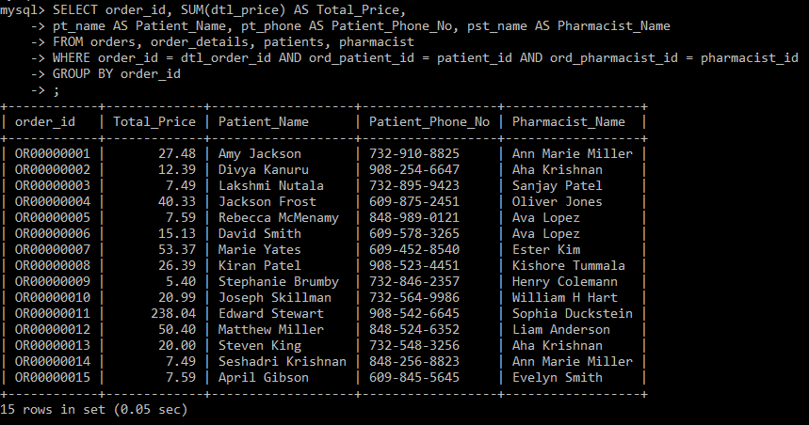
Queries Statements and Results
Patients Prescription Order Total Cost

Slide 26
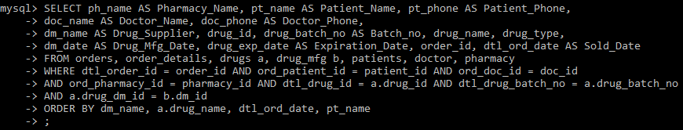
Queries Statements and Results
Tracking Drug Dispense information to Patient, Doctor by Drug Mfg, Drug Name, Batch#, Mfg date, Expiration Date

Slide 27
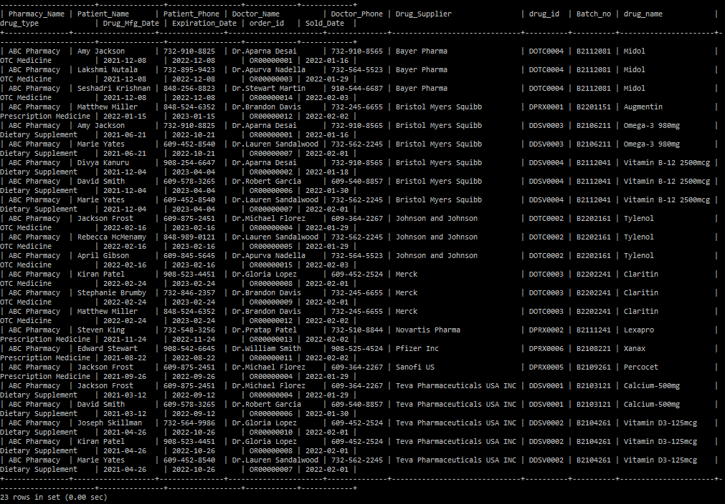

Slide 28

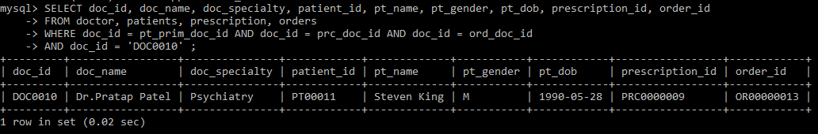
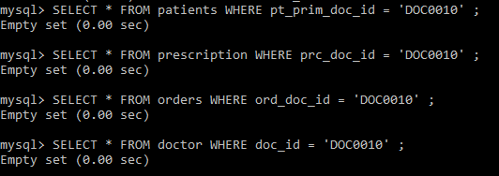
Database Max Functionality
Deleting Row Where Doc_ID = ‘DOC0010’ (Affects tables Doctor, Patients, Prescription, Orders and their child tables)

